Slide 1
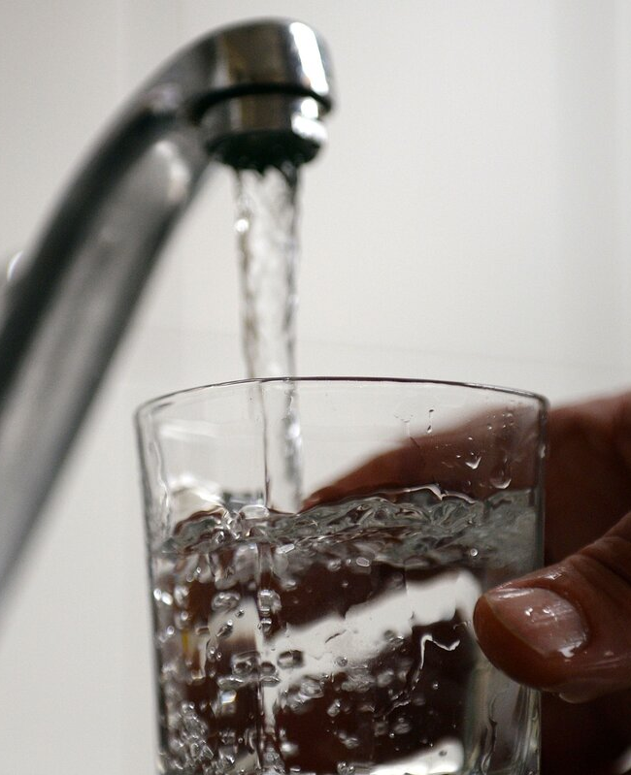

US Drinking Water Regulations and Databases
Natchaya (Jade) Luangphairin
Aquatic Chemistry, Fall ‘24

Slide 2
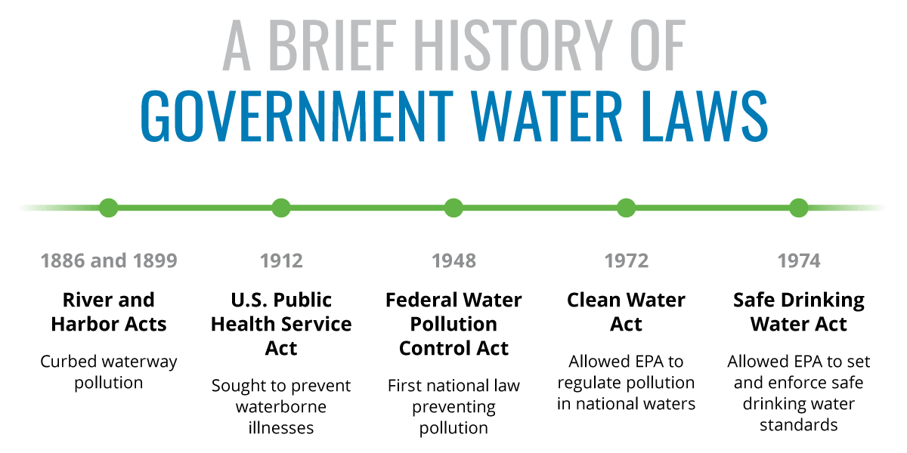

Slide 3
Towards end of 1950s-public began to express growing concern about the environmental impacts that WE THE PEOPLE were having on.
Bills like Resource and Conservation Act
1969 Ohio Cuyahoga River caught on fire

Slide 4

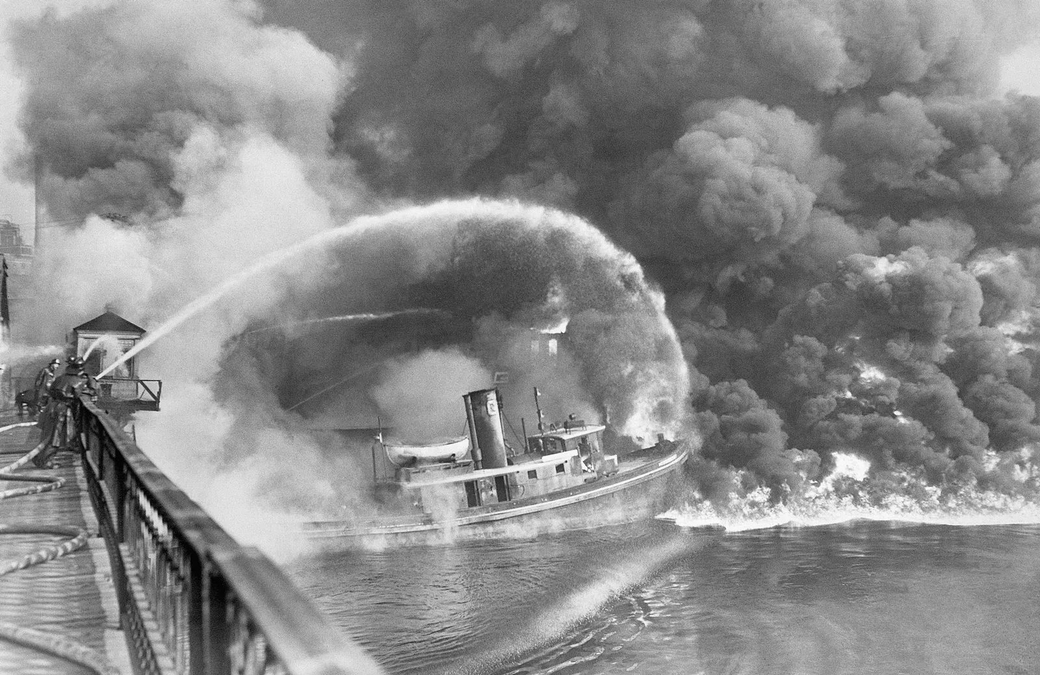

Dec 2nd, 1970
Towards end of 1950s-public began to express growing concern about the environmental impacts that WE THE PEOPLE were having on.
Bills like Resource and Conservation Act
1969 Ohio Cuyahoga River caught on fire
The element we use to put out fire CAUGHT ON FIRE! -> Industrial pollution

Slide 5
Dec 2nd, 1970
Towards end of 1950s-public began to express growing concern about the environmental impacts that WE THE PEOPLE were having on.
Bills like Resource and Conservation Act
1969 Ohio Cuyahoga River caught on fire

Slide 6
Dec 2nd, 1970
Towards end of 1950s-public began to express growing concern about the environmental impacts that WE THE PEOPLE were having on.
Bills like Resource and Conservation Act
1969 Ohio Cuyahoga River caught on fire

Slide 7
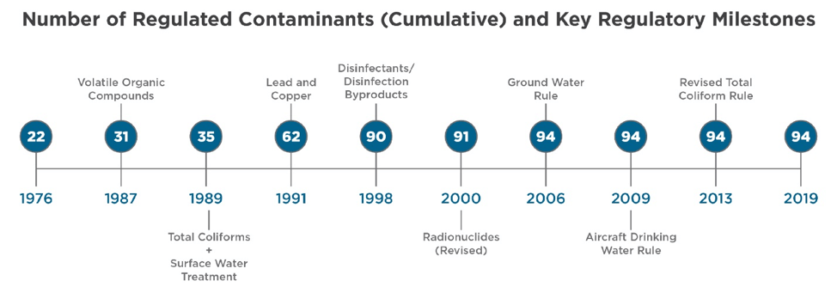
The 1996 Safe Drinking Water Act (SDWA) amendments require that once every five years EPA issue a new Contaminant Candidate List (CCL) of no more than 30 unregulated contaminants to be monitored by public water systems (PWSs)
Click Link
Regulation Timeline

Slide 8
Regulation
Link to: Regulation Timeline
Why do we care? Policy drives EVERYTHING
Academia: Research
Government/Utilities: Compliance
Industry/Consulting: Design
Consumers: Health
Publish papers with just data!
Acquah, Sarah, and Maura Allaire. 2023. “Disparities in Drinking Water Quality: Evidence from California.” Water Policy 25 (2): 69–86. https://doi.org/10.2166/wp.2023.068.
Allaire, Maura, and Sarah Acquah. 2022. “Disparities in Drinking Water Compliance: Implications for Incorporating Equity into Regulatory Practices.” AWWA Water Science 4 (2): e1274. https://doi.org/10.1002/aws2.1274.
Allaire, Maura, Haowei Wu, and Upmanu Lall. 2018. “National Trends in Drinking Water Quality Violations.” Proceedings of the National Academy of Sciences 115 (9): 2078–83. https://doi.org/10.1073/pnas.1719805115.
Martinez-Morata, Irene, Benjamin C. Bostick, Otakuye Conroy-Ben, Dustin T. Duncan, Miranda R. Jones, Maya Spaur, Kevin P. Patterson, Seth J. Prins, Ana Navas-Acien, and Anne E. Nigra. 2022. “Nationwide Geospatial Analysis of County Racial and Ethnic Composition and Public Drinking Water Arsenic and Uranium.” Nature Communications 13 (1): 7461. https://doi.org/10.1038/s41467-022-35185-6.
Spaur, Maya, Benjamin C. Bostick, Steven N. Chillrud, Pam Factor-Litvak, Ana Navas-Acien, and Anne E. Nigra. 2023. “Impact of Lowering the US Maximum Contaminant Level on Arsenic Exposure: Differences by Race, Region, and Water Arsenic in NHANES 2003–2014.” Environmental Pollution 333 (September):122047. https://doi.org/10.1016/j.envpol.2023.122047.

Slide 9
Three Database
Toxicology: List of IRIS Chemicals in the Comptox Chemistry Dashboard
Monitoring: Six-Year Review (SYR)
Violations: SDWIS Federal Reports (Violations)

Slide 10
Three Database
Toxicology: List of IRIS Chemicals in the Comptox Chemistry Dashboard
Monitoring: Six-Year Review (SYR)
Violations: SDWIS Federal Reports (Violations)
Unregulated Contaminant Monitoring Rule (UCMR)
Don’t forget me! I’m your only place to get data on unregulated contaminants.
Sincerely,
UCMR

Slide 11


List unregulated contaminants every 5 years
Draft/Final
Contaminant Candidate List
(CCL)
General Flow of SDWA Regulatory Processes
Opportunity for Public Review and Comment
RECAP
Research Needs Assessment
Final CCL
Safe Drinking Water Information System (SDWIS)
Reports violations, treatment, geographic area, water system info (size/source), water system facility info (seller/buyer), and more…
Determine whether at least 5 need a drinking water standard
Prelim/Final
Regulatory Determinations
(RegDet)
If yes
Develop or revise the drinking water standard
Proposed/Final
Regulation Development
(NPDWR)
Final CCL list to draft UCMR
24 months to develop proposed reg.
If yes
List and collect monitoring data for up to 30 unregulated contaminants
Draft/Final/Monitoring Results
Unregulated Contaminant Monitoring Rule (UCMR)
Review and decide whether to revise the standard every 6 years
Six-Year Review (SYR)
Monitoring Results
18 months from proposed NPDWR to final NPDWR rule.
Can request extension to the deadline.
If decision is not to regulate, then no further action required.
May develop health advisory (HA).
At each stage, need increased specificity and confidence, using the best supporting data available (e.g. toxicity, health and occurrence).

Slide 12
SDWA specifies THREE CRITERIA that must be met in order for development of a national regulation:
Contaminant has adverse health effects on people.
Contaminant known to occur/substantial likelihood to occur in a PWS at a frequency and level of concern.
Regulation of contaminant presents “meaningful opportunity” to reduce health risks for populations served by public water.
List unregulated contaminants every 5 years
Draft/Final
Contaminant Candidate List
(CCL)
General Flow of SDWA Regulatory Processes
Opportunity for Public Review and Comment
RECAP
Research Needs Assessment
Final CCL
Safe Drinking Water Information System (SDWIS)
Reports violations, treatment, geographic area, water system info (size/source), water system facility info (seller/buyer), and more…
Determine whether at least 5 need a drinking water standard
Prelim/Final
Regulatory Determinations
(RegDet)
If yes
Develop or revise the drinking water standard
Proposed/Final
Regulation Development
(NPDWR)
Final CCL list to draft UCMR
24 months to develop proposed reg.
If yes
List and collect monitoring data for up to 30 unregulated contaminants
Draft/Final/Monitoring Results
Unregulated Contaminant Monitoring Rule (UCMR)
Review and decide whether to revise the standard every 6 years
Six-Year Review (SYR)
Monitoring Results
18 months from proposed NPDWR to final NPDWR rule.
Can request extension to the deadline.
If decision is not to regulate, then no further action required.
May develop health advisory (HA).
At each stage, need increased specificity and confidence, using the best supporting data available (e.g. toxicity, health and occurrence).

Slide 13
List unregulated contaminants every 5 years
Draft/Final
Contaminant Candidate List
(CCL)
General Flow of SDWA Regulatory Processes
Opportunity for Public Review and Comment
RECAP
Research Needs Assessment
Final CCL
Safe Drinking Water Information System (SDWIS)
Reports violations, treatment, geographic area, water system info (size/source), water system facility info (seller/buyer), and more…
Determine whether at least 5 need a drinking water standard
Prelim/Final
Regulatory Determinations
(RegDet)
If yes
Develop or revise the drinking water standard
Proposed/Final
Regulation Development
(NPDWR)
Final CCL list to draft UCMR
24 months to develop proposed reg.
If yes
List and collect monitoring data for up to 30 unregulated contaminants
Draft/Final/Monitoring Results
Unregulated Contaminant Monitoring Rule (UCMR)
Review and decide whether to revise the standard every 6 years
Six-Year Review (SYR)
Monitoring Results
18 months from proposed NPDWR to final NPDWR rule.
Can request extension to the deadline.
If decision is not to regulate, then no further action required.
May develop health advisory (HA).
At each stage, need increased specificity and confidence, using the best supporting data available (e.g. toxicity, health and occurrence).

Slide 14
Classes of Contaminants
National Primary Drinking Water Regulation (NPDWR)
Microorganisms
Disinfection Byproducts
Radionuclides
Organic Chemicals
Inorganic Chemicals
Disinfectants
Asbestos, Benzene, Dichloromethan, Manganese, PCB
Arsenic, Lead, Fluoride, Mercury, Nitrate/Nitrite
Chlorine (free chlorine, chloramine)
HAA, TTHMs, Bromate
Total Coliform (E.Coli), Legionela
Uranium, Radium
SDWA Datasets from ECHO contains SDWA reference codes: https://echo.epa.gov/tools/data-downloads#drinkingwater
Includes contaminant code, violation code, source code, rule code, etc.

Slide 15
Contaminant: | Class: | Assigned to:
Arsenic (1005) | Inorganic | Manish Adhikari
Asbestos (1094) | Inorganic | M. Andrew Glass
Dichloromethane (DCM) (2964) | Organic | Tione Grant
Lead (1030) | Inorganic | Maximilian Honigfort
HAA5 (2456) | Disinfection Byproducts | Jordin Kahler
Fluoride (1025) | Inorganic | Camille Kima
Uranium (4006) | Radionuclide | Elissa Touma

Slide 16
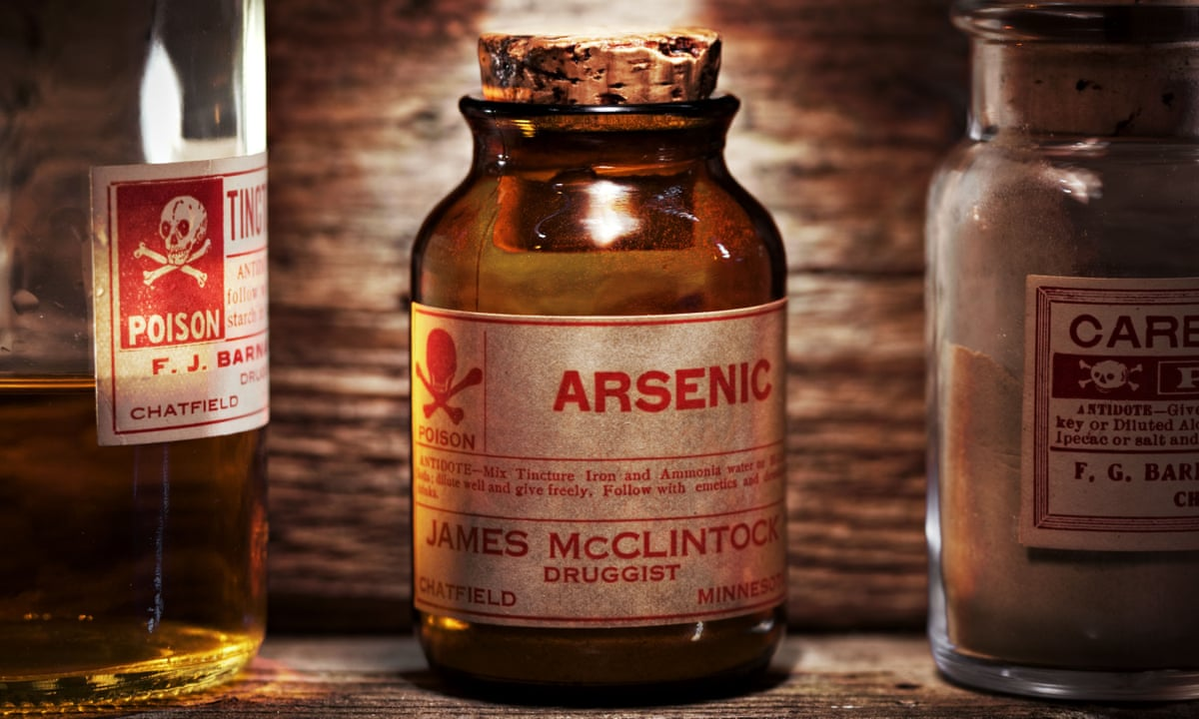

Slide 17
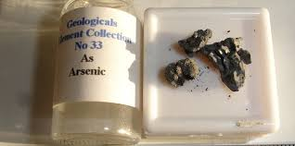

Slide 18
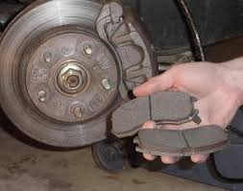

Slide 19
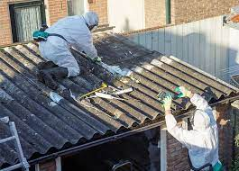

Slide 20
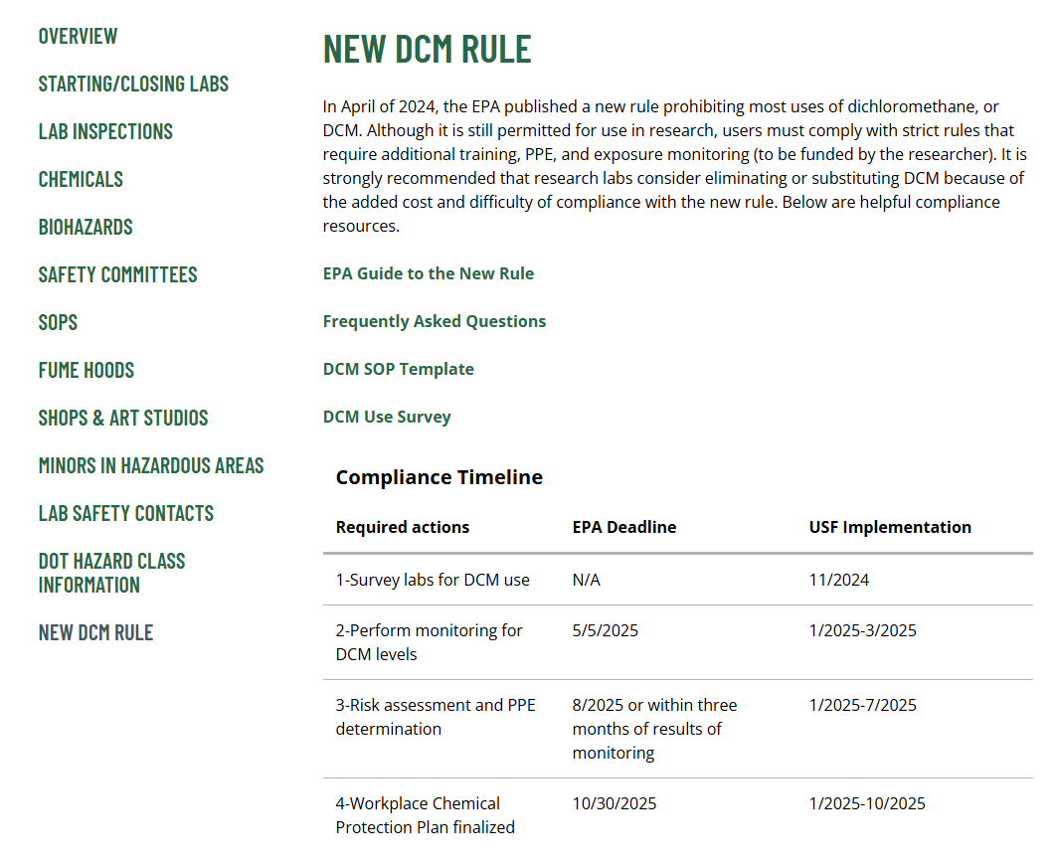

Slide 21
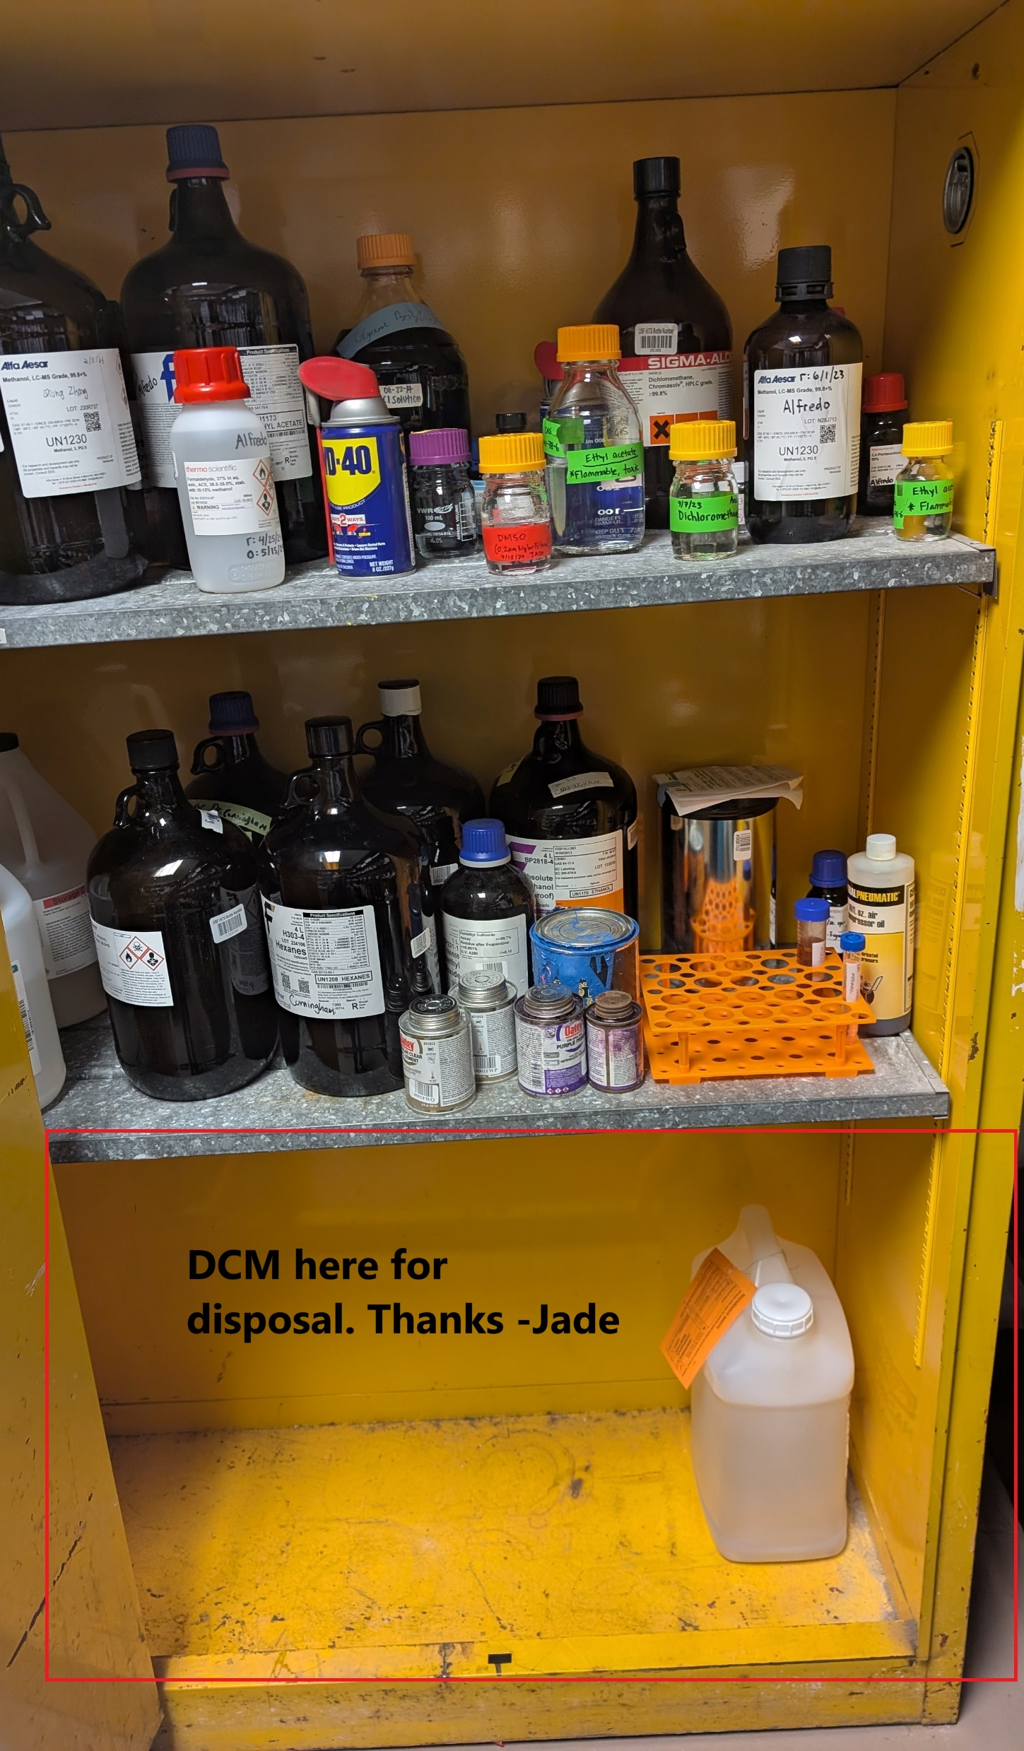

Slide 22
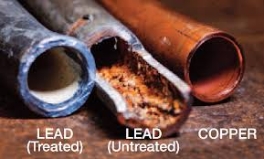

Slide 23
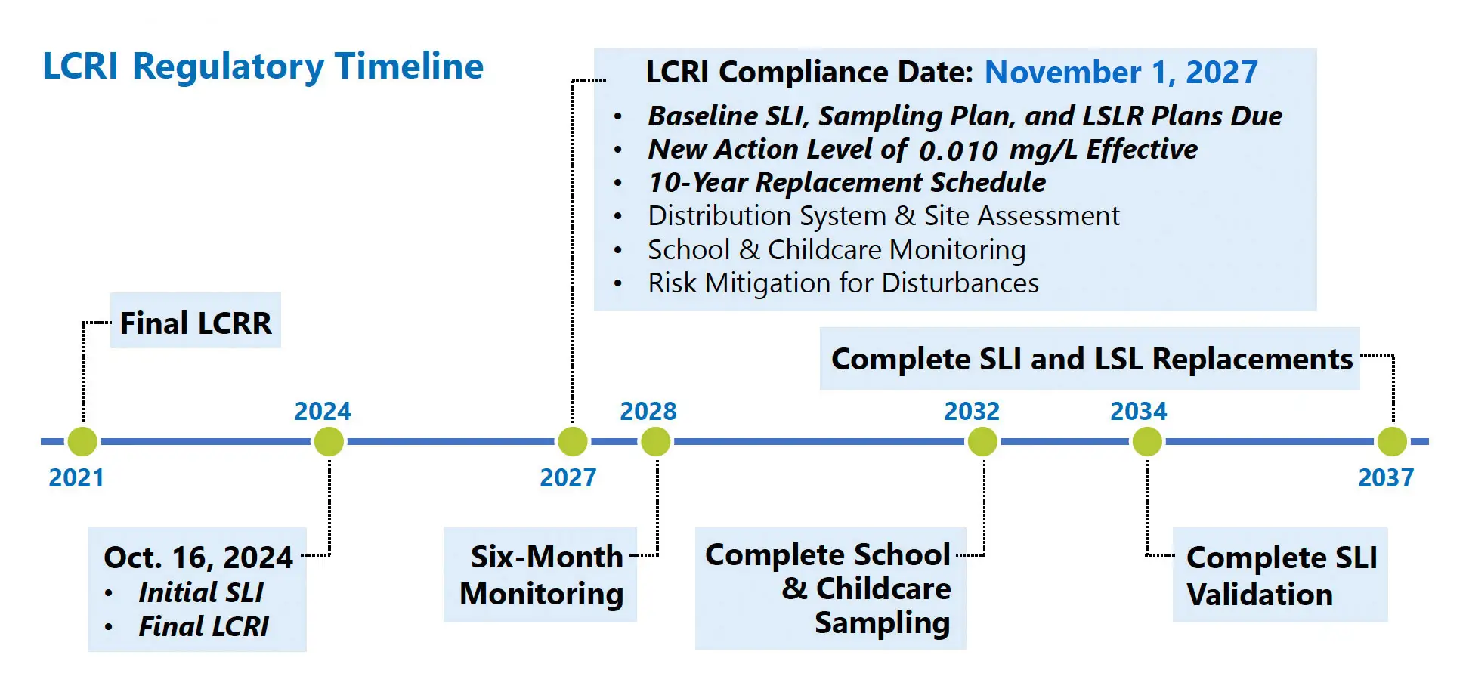

Slide 24
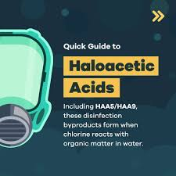
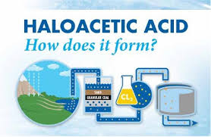

Slide 25
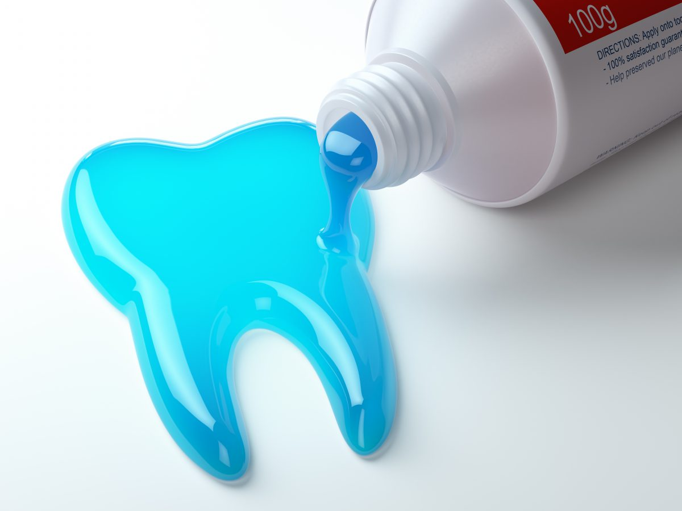
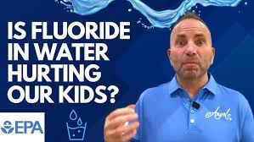

Slide 26
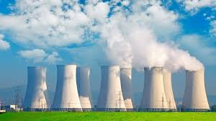
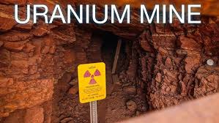

Slide 27
USEPA REGULATIONS PROJECT (ENV6666)
The goal of the project is for you to educate your classmates on the following aspects of your assigned contaminant:
What is the toxicity? (Review the toxicology data used in setting the MCL from the IRIS database)
What is the occurrence? Touch on two aspects of occurrence (remember, CWS only). Please analyze the data both by state occurrence and system size. Try to classify who is impacted by this contaminant.
Using the Six-year review data---look at the distribution of concentrations for that contaminant. How does it break down? Are there systems that are more likely to have higher concentrations (system size? source water type? etc)
Using SDWIS Federal reports—review MCL violation data for that contaminant on a national basis. Are there geographical hotspots? Are there yearly trends? Hypothesis regarding trends?
What happens if a utility exceeds the regulatory threshold (MCL)?
Treatment---how can utilities effectively remove the contaminant.
Report: Two-page briefing memo per group, uploaded by one member to Canvas (due Dec 6th).
Presentation: Dec 3rd and 5th. Each person will present a 10 min presentation on your results. Highlight the why we should care and the results/discussion and conclusions. All members must participate in the presentation for a grade.
What is the toxicity? How is it decided?

Slide 28
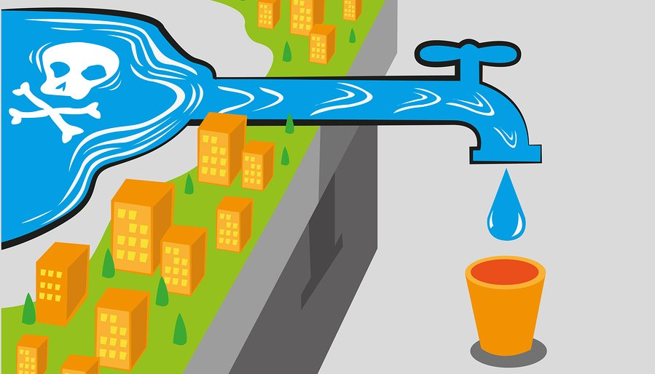
What is the toxicity?
See USEPA IRIS Information
List of IRIS Chemicals in the Comptox Chemistry Dashboard and Drinking Water Treatment Technologies. For EPA reference on health advisories, read EPA Drinking Water Standards and Health Advisories tables

Slide 29
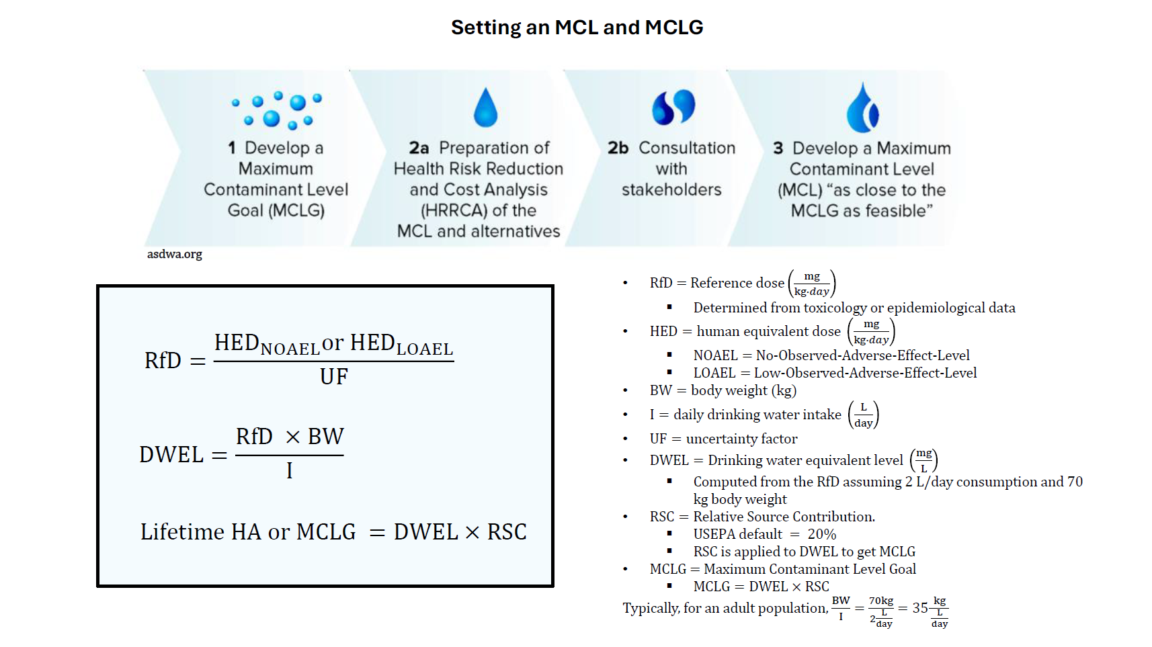

Slide 30
MCLG isn’t enforceable because it may not always be practical or technologically feasible to achieve. EPA sets MCL and names a best available technology (BAT).

Slide 31
MCLG isn’t enforceable because it may not always be practical or technologically feasible to achieve. EPA sets MCL and names a best available technology (BAT).
1. Let’s explore the List of IRIS Chemicals in the Comptox Chemistry Dashboard; Drinking Water Treatment Technologies; EPA Drinking Water Standards and Health Advisories tables

Slide 32
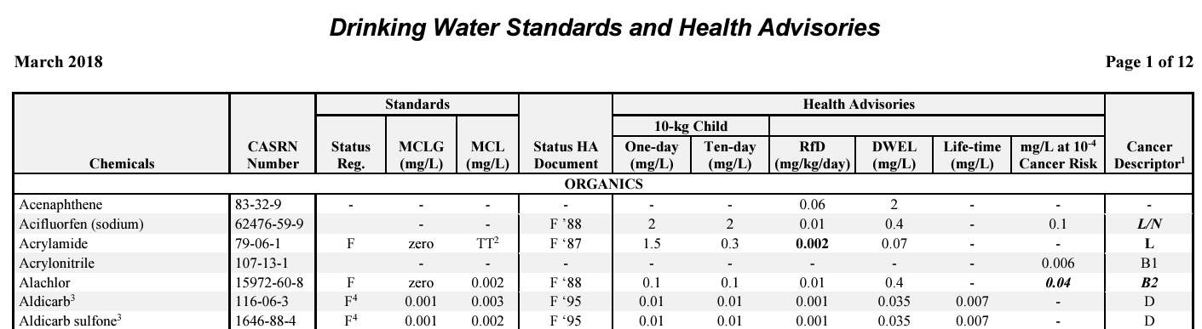
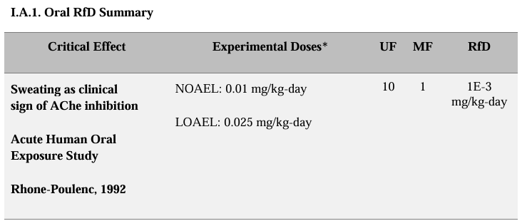
Example: Aldicarb
For definitions (MCL, MCLG, HA, RfD, DWEL, etc) see Page v-viii
EPA Drinking Water Standards and Health Advisories tables
https://iris.epa.gov/ChemicalLanding/&substance_nmbr=3

Slide 33
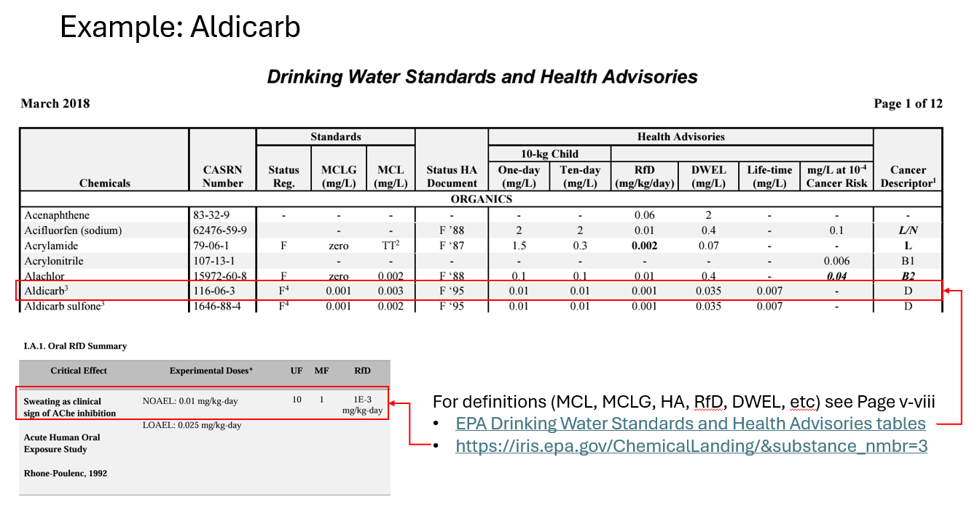
Value given by table:
NOEL = 0.01 mg/kg/day
UF = 10
BW = 70 kg
I = 2 L/day
RSC = 20% = 0.2

Slide 34
Example: Aldicarb
Value given by table:
NOEL = 0.01 mg/kg/day
UF = 10
BW = 70 kg
I = 2 L/day
RSC = 20% = 0.2

Slide 35
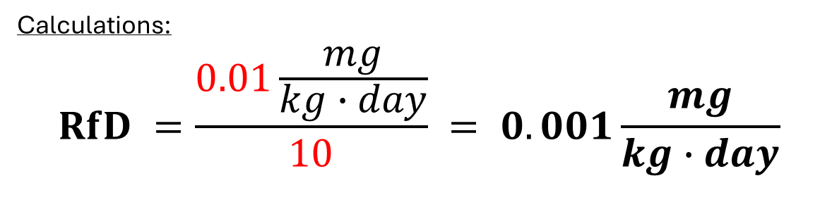
Example: Aldicarb
Calculations:
$$RfD =\frac{0.01\frac{mg}{kg∙day}}{10} = 0.001\frac{mg}{kg∙day}$$
Value given by table:
NOEL = 0.01 mg/kg/day
UF = 10
BW = 70 kg
I = 2 L/day
RSC = 20% = 0.2

Slide 36
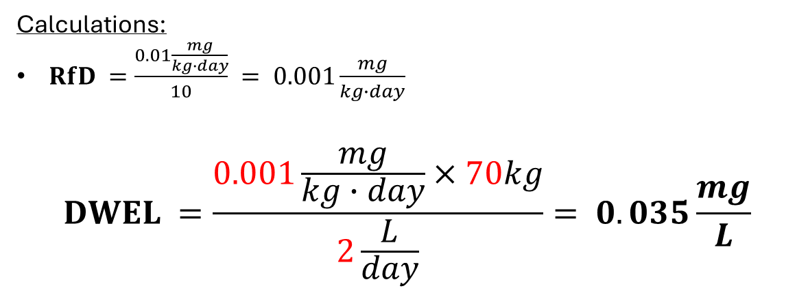
Example: Aldicarb
Calculations:
$RfD =\frac{0.01\frac{mg}{kg∙day}}{10} = 0.001\frac{mg}{kg∙day}$
$$DWEL =\frac{0.001\frac{mg}{kg∙day}×70kg}{2\frac{L}{day}}= 0.035\frac{mg}{L}$$
Value given by table:
NOEL = 0.01 mg/kg/day
UF = 10
BW = 70 kg
I = 2 L/day
RSC = 20% = 0.2

Slide 37
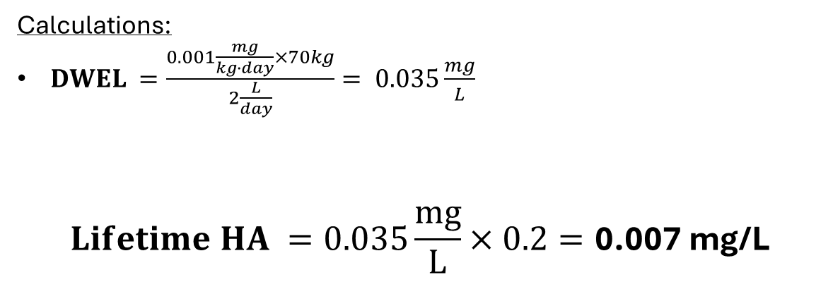
Example: Aldicarb
Max conc. Considered safe for lifetime exposure used when no MCL
Calculations:
$DWEL =\frac{0.001\frac{mg}{kg∙day}×70kg}{2\frac{L}{day}}= 0.035\frac{mg}{L}$
$$Lifetime HA =0.035\frac{mg}{L}×0.2=\text{0.007 }\text{mg}\text{/}\text{L}$$
Value given by table:
NOEL = 0.01 mg/kg/day
UF = 10
BW = 70 kg
I = 2 L/day
RSC = 20% = 0.2

Slide 38
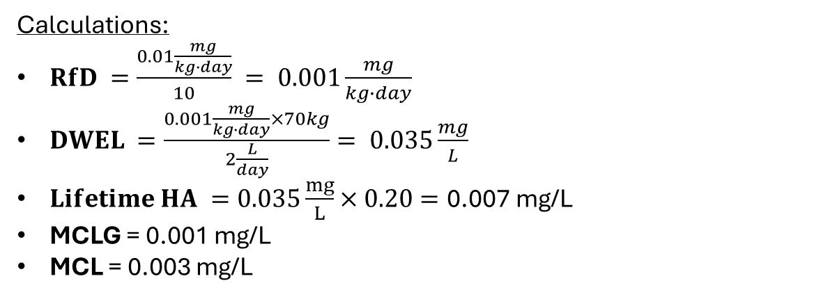
Example: Aldicarb
Calculations:
$RfD =\frac{0.01\frac{mg}{kg∙day}}{10} = 0.001\frac{mg}{kg∙day}$
$DWEL =\frac{0.001\frac{mg}{kg∙day}×70kg}{2\frac{L}{day}}= 0.035\frac{mg}{L}$
$Lifetime HA =0.035\frac{mg}{L}×0.20=\text{0.007 }\text{mg}\text{/}\text{L}$
MCLG = 0.001 mg/L
MCL = 0.003 mg/L
Value given by table:
NOEL = 0.01 mg/kg/day
UF = 10
BW = 70 kg
I = 2 L/day
RSC = 20% = 0.2

Slide 39


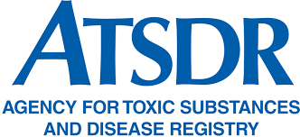
Example: Aldicarb
HA can be developed by separate agencies
Calculations:
$RfD =\frac{0.01\frac{mg}{kg∙day}}{10} = 0.001\frac{mg}{kg∙day}$
$DWEL =\frac{0.001\frac{mg}{kg∙day}×70kg}{2\frac{L}{day}}= 0.035\frac{mg}{L}$
$Lifetime HA =0.035\frac{mg}{L}×0.20=\text{0.007 }\text{mg}\text{/}\text{L}$
MCLG = 0.001 mg/L
MCL = 0.003 mg/L
Value given by table:
NOEL = 0.01 mg/kg/day
UF = 10
BW = 70 kg
I = 2 L/day
RSC = 20% = 0.2
Non-enforceable

Slide 40

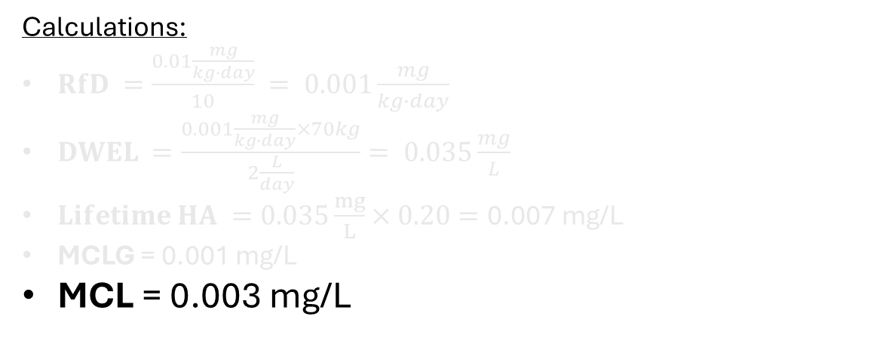
Example: Aldicarb
“I typically also recommend a treatment technology but don’t really care which you use as long as it is below, I am happy.”
Calculations:
$RfD =\frac{0.01\frac{mg}{kg∙day}}{10} = 0.001\frac{mg}{kg∙day}$
$DWEL =\frac{0.001\frac{mg}{kg∙day}×70kg}{2\frac{L}{day}}= 0.035\frac{mg}{L}$
$Lifetime HA =0.035\frac{mg}{L}×0.20=\text{0.007 }\text{mg}\text{/}\text{L}$
MCLG = 0.001 mg/L
MCL = 0.003 mg/L
Value given by table:
NOEL = 0.01 mg/kg/day
UF = 10
BW = 70 kg
I = 2 L/day
RSC = 20% = 0.2
Enforceable!

Slide 41
USEPA REGULATIONS PROJECT (ENV6666)
The goal of the project is for you to educate your classmates on the following aspects of your assigned contaminant:
What is the toxicity? (Review the toxicology data used in setting the MCL from the IRIS database)
What is the occurrence? Touch on two aspects of occurrence (remember, CWS only). Please analyze the data both by state occurrence and system size. Try to classify who is impacted by this contaminant.
Using the Six year review data---look at the distribution of concentrations for that contaminant. How does it break down? Are there systems that are more likely to have higher concentrations (system size? source water type? etc)
Using SDWIS Federal reports—review MCL violation data for that contaminant on a national basis. Are there geographical hotspots? Are there yearly trends? Hypothesis regarding trends?
What happens if a utility exceeds the regulatory threshold (MCL)?
Treatment---how can utilities effectively remove the contaminant.
Report: Two-page briefing memo per group, uploaded by one member to Canvas (due Dec 6th).
Presentation: Dec 3rd and 5th. Each person will present a 10 min presentation on your results. Highlight the why we should care and the results/discussion and conclusions. All members must participate in the presentation for a grade.
Now that we understand toxicity, how often do they occur?

Slide 42
USEPA REGULATIONS PROJECT (ENV6666)
The goal of the project is for you to educate your classmates on the following aspects of your assigned contaminant:
What is the toxicity? (Review the toxicology data used in setting the MCL from the IRIS database)
What is the occurrence? Touch on two aspects of occurrence (remember, CWS only). Please analyze the data both by state occurrence and system size. Try to classify who is impacted by this contaminant.
Using the Six year review data---look at the distribution of concentrations for that contaminant. How does it break down? Are there systems that are more likely to have higher concentrations (system size? source water type? etc)
Using SDWIS Federal reports—review MCL violation data for that contaminant on a national basis. Are there geographical hotspots? Are there yearly trends? Hypothesis regarding trends?
What happens if a utility exceeds the regulatory threshold (MCL)?
Treatment---how can utilities effectively remove the contaminant.
Report: Two-page briefing memo per group, uploaded by one member to Canvas (due Dec 6th).
Presentation: Dec 3rd and 5th. Each person will present a 10 min presentation on your results. Highlight the why we should care and the results/discussion and conclusions. All members must participate in the presentation for a grade.
Before we begin…What is a CWS. Is it like a common drinking cup?

Slide 43
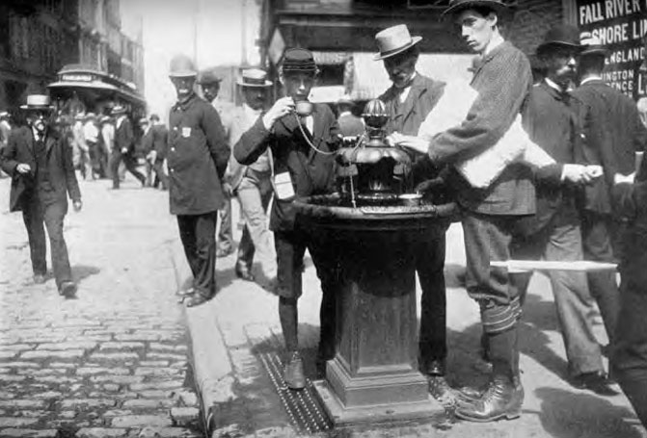
USEPA REGULATIONS PROJECT (ENV6666)
The goal of the project is for you to educate your classmates on the following aspects of your assigned contaminant:
What is the toxicity? (Review the toxicology data used in setting the MCL from the IRIS database)
What is the occurrence? Touch on two aspects of occurrence (remember, CWS only). Please analyze the data both by state occurrence and system size. Try to classify who is impacted by this contaminant.
Using the Six year review data---look at the distribution of concentrations for that contaminant. How does it break down? Are there systems that are more likely to have higher concentrations (system size? source water type? etc)
Using SDWIS Federal reports—review MCL violation data for that contaminant on a national basis. Are there geographical hotspots? Are there yearly trends? Hypothesis regarding trends?
What happens if a utility exceeds the regulatory threshold (MCL)?
Treatment---how can utilities effectively remove the contaminant.
Report: Two-page briefing memo per group, uploaded by one member to Canvas (due Dec 6th).
Presentation: Dec 3rd and 5th. Each person will present a 10 min presentation on your results. Highlight the why we should care and the results/discussion and conclusions. All members must participate in the presentation for a grade.
Before we begin…What is a CWS. Is it like a common drinking cup?

Slide 44
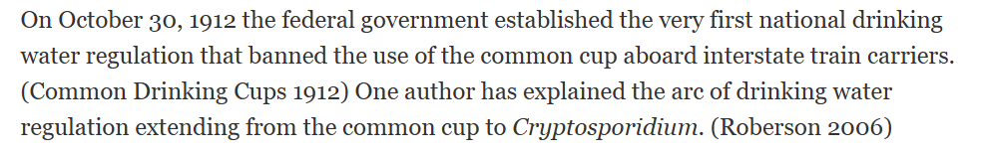
USEPA REGULATIONS PROJECT (ENV6666)
The goal of the project is for you to educate your classmates on the following aspects of your assigned contaminant:
What is the toxicity? (Review the toxicology data used in setting the MCL from the IRIS database)
What is the occurrence? Touch on two aspects of occurrence (remember, CWS only). Please analyze the data both by state occurrence and system size. Try to classify who is impacted by this contaminant.
Using the Six year review data---look at the distribution of concentrations for that contaminant. How does it break down? Are there systems that are more likely to have higher concentrations (system size? source water type? etc)
Using SDWIS Federal reports—review MCL violation data for that contaminant on a national basis. Are there geographical hotspots? Are there yearly trends? Hypothesis regarding trends?
What happens if a utility exceeds the regulatory threshold (MCL)?
Treatment---how can utilities effectively remove the contaminant.
Report: Two-page briefing memo per group, uploaded by one member to Canvas (due Dec 6th).
Presentation: Dec 3rd and 5th. Each person will present a 10 min presentation on your results. Highlight the why we should care and the results/discussion and conclusions. All members must participate in the presentation for a grade.
Before we begin…What is a CWS. Is it like a common drinking cup?
https://safedrinkingwaterdotcom.wordpress.com/2012/10/29/100-years-of-outlawing-the-common-cup/

Slide 45
Classifications
A public water system (PWS) have at least 15 service connections or serves an average of at least 25 people for at least 60 days a year. It can be publicly or privately owned. EPA has defined three types of public water systems:
Community Water System (CWS): supplies water to the same population year-round. (e.g. City of Tampa Water Department)
Non-Transient Non-Community Water System (NTNCWS): regularly supplies water to at least 25 of the same people at least 6 months/year. (e.g. schools, factories, office buildings, and hospitals which have their own water systems.)
Transient Non-Community Water System (TNCWS): provides water in a place where people do not remain for long periods of time. (e.g. gas station or campground)
There are over 148,000 public water systems in the United States
Each has a public water system identifier (PWSID)

Slide 46
Classifications
A public water system (PWS) have at least 15 service connections or serves an average of at least 25 people for at least 60 days a year. It can be publicly or privately owned. EPA has defined three types of public water systems:
Community Water System (CWS): supplies water to the same population year-round. (e.g. City of Tampa Water Department)
Non-Transient Non-Community Water System (NTNCWS): regularly supplies water to at least 25 of the same people at least 6 months/year. (e.g. schools, factories, office buildings, and hospitals which have their own water systems.)
Transient Non-Community Water System (TNCWS): provides water in a place where people do not remain for long periods of time. (e.g. gas station or campground)
There are over 148,000 public water systems in the United States
Each has a public water system identifier (PWSID)
In this project, you will be focusing on analyzing data for “active CWS” only.

Slide 47
What is the occurrence?
See Six-Year Review (SYR)
See SDWIS Federal Reports (Violations)

Slide 48
USEPA REGULATIONS PROJECT (ENV6666)
The goal of the project is for you to educate your classmates on the following aspects of your assigned contaminant:
What is the toxicity? (Review the toxicology data used in setting the MCL from the IRIS database)
What is the occurrence? Touch on two aspects of occurrence (remember, CWS only). Please analyze the data both by state occurrence and system size. Try to classify who is impacted by this contaminant.
Using the Six-year review data---look at the distribution of concentrations for that contaminant. How does it break down? Are there systems that are more likely to have higher concentrations (system size? source water type? etc)
Using SDWIS Federal reports—review MCL violation data for that contaminant on a national basis. Are there geographical hotspots? Are there yearly trends? Hypothesis regarding trends?
What happens if a utility exceeds the regulatory threshold (MCL)?
Treatment---how can utilities effectively remove the contaminant.
Report: Two-page briefing memo per group, uploaded by one member to Canvas (due Dec 6th).
Presentation: . Each person will present a 10 min presentation on your results. Highlight the why we should care and the results/discussion and conclusions. All members must participate in the presentation for a grade.
2. Let’s explore the Six-Year Review (SYR)

Slide 49
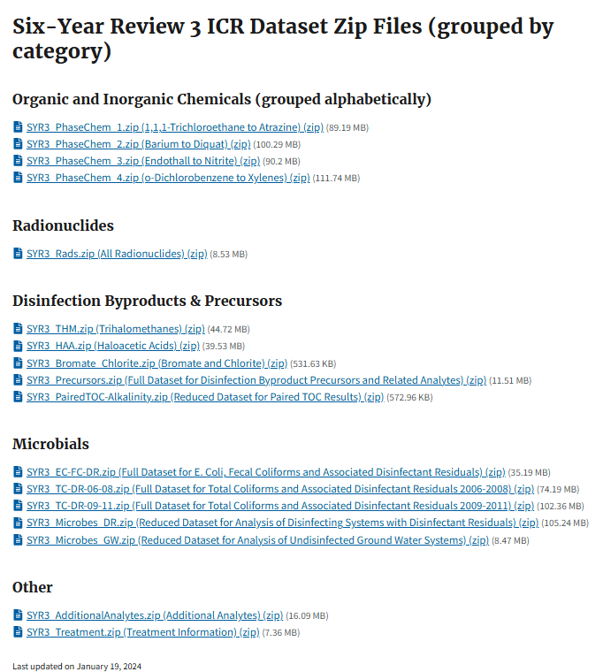

Slide 50
USEPA REGULATIONS PROJECT (ENV6666)
The goal of the project is for you to educate your classmates on the following aspects of your assigned contaminant:
What is the toxicity? (Review the toxicology data used in setting the MCL from the IRIS database)
What is the occurrence? Touch on two aspects of occurrence (remember, CWS only). Please analyze the data both by state occurrence and system size. Try to classify who is impacted by this contaminant.
Using the Six-year review data---look at the distribution of concentrations for that contaminant. How does it break down? Are there systems that are more likely to have higher concentrations (system size? source water type? etc)
Using SDWIS Federal reports—review MCL violation data for that contaminant on a national basis. Are there geographical hotspots? Are there yearly trends? Hypothesis regarding trends?
What happens if a utility exceeds the regulatory threshold (MCL)?
Treatment---how can utilities effectively remove the contaminant.
Report: Two-page briefing memo per group, uploaded by one member to Canvas (due Dec 6th).
Presentation: Dec 3rd and 5th. Each person will present a 10 min presentation on your results. Highlight the why we should care and the results/discussion and conclusions. All members must participate in the presentation for a grade.
3. Let’s explore the SDWIS Federal Reports (Violations)

Slide 51
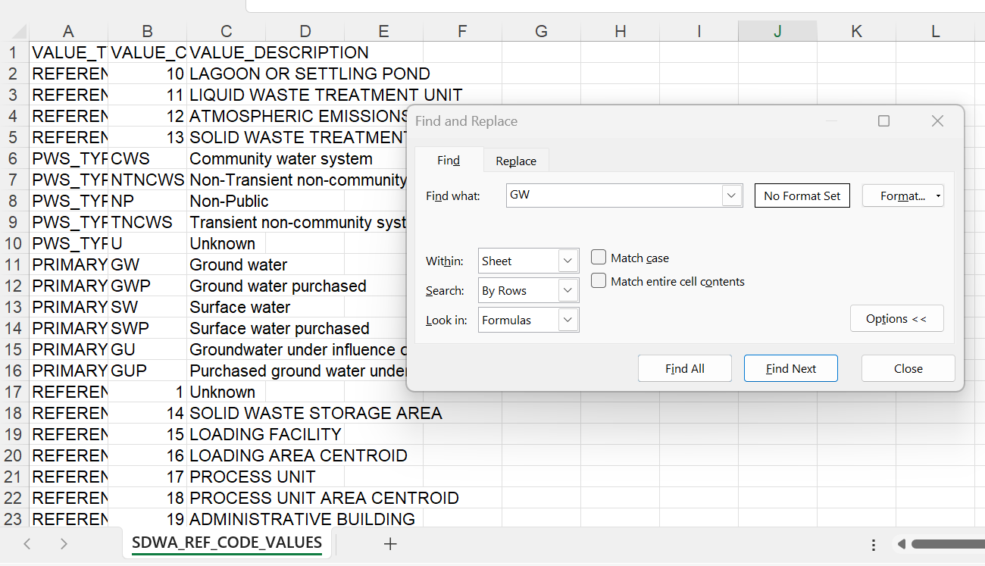
Reference: Ctrl+f in the excel spreadsheet SDWA_REF_CODE_VALUES.csv to define the column names and value descriptions

Slide 52
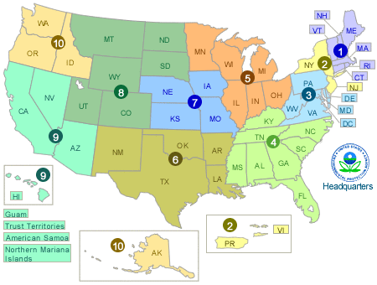
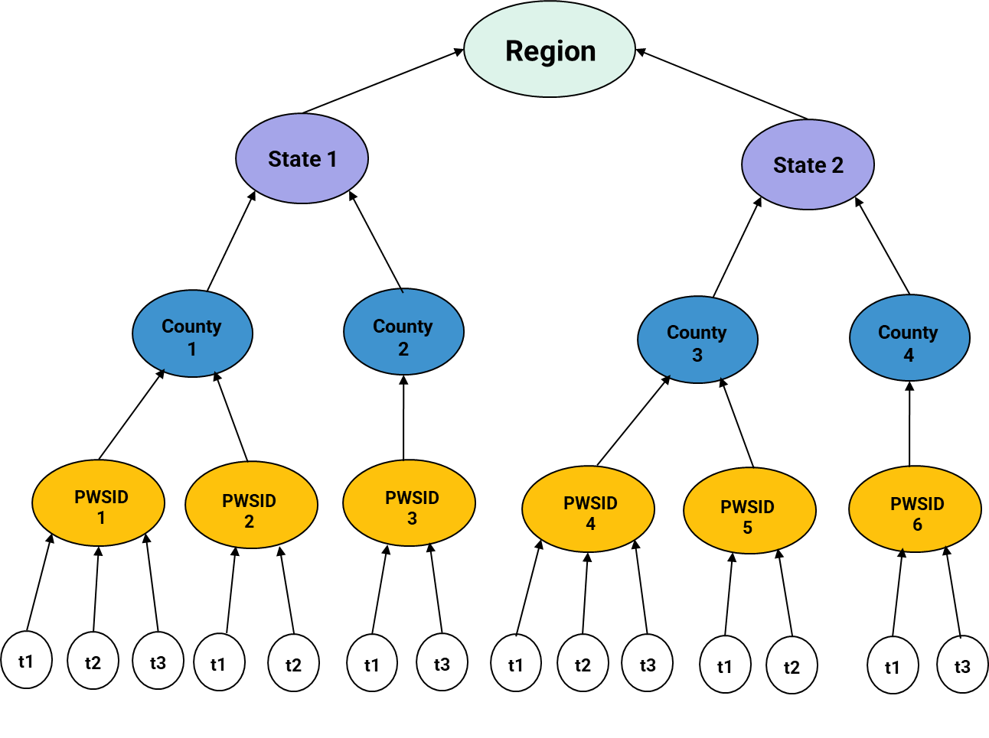
Data Aggregation
Q1. Group by: PWSID? State? County? EPA Region?
Q2. Daily? Monthly? Quarterly? Yearly?
Q3. Average? Percentile? Median?

Slide 53
System Characteristics: who is impacted by the contaminant?
Size category (based on people served by the system)
1 = Very Small <=500
2 = Small 501-3,300
3 = Medium 3,301-10,000
4 = Large 10,001-100,000
5 = Very large >100,000
Water Source
GW: Groundwater
GU: Groundwater under the influence of surface water
GWP: Groundwater purchased
SW: Surface water
SWP: Surface water purchased

Slide 54
Also think about…
How to handle censored and missing data (NAs)
Exclude NAs
MRL/2
1E-6
What do you want to know? Hypothesis.
Frequency of violation and what type
Occurrence and concentrations
Who are the repeat violators
How long do violations last before return to compliance?
Utility characteristics
Intervention analysis
What type of analysis (statistical, spatial, temporal, etc):
Timeseries
Correlation plot
Histogram
Pie Chart
Boxplots
Maps
DOI:10.1002/9781118162729

Slide 55
USEPA REGULATIONS PROJECT (ENV6666)
The goal of the project is for you to educate your classmates on the following aspects of your assigned contaminant:
What is the toxicity? (Review the toxicology data used in setting the MCL from the IRIS database)
What is the occurrence? Touch on two aspects of occurrence (remember, CWS only). Please analyze the data both by state occurrence and system size. Try to classify who is impacted by this contaminant.
Using the Six-year review data---look at the distribution of concentrations for that contaminant. How does it break down? Are there systems that are more likely to have higher concentrations (system size? source water type? etc)
Using SDWIS Federal reports—review MCL violation data for that contaminant on a national basis. Are there geographical hotspots? Are there yearly trends? Hypothesis regarding trends?
What happens if a utility exceeds the regulatory threshold (MCL)?
Treatment---how can utilities effectively remove the contaminant.
Report: Two-page briefing memo per group, uploaded by one member to Canvas (due Dec 6th).
Presentation: Dec 3rd and 5th. Each person will present a 10 min presentation on your results. Highlight the why we should care and the results/discussion and conclusions. All members must participate in the presentation for a grade.
What happens if a utility violates?

Slide 56
"What happens if a utility exceeds a regulatory threshold?”
When a Public Water System (PWS) violates regulations, such as exceeding Maximum Contaminant Levels (MCL), it:
must issue a notice within 24 hours.
must correct the issue.
risks being added by EPA to their list of serious violators.
could face enforcement action by EPA, financial or legal actions, if fail to resolve and system has been in noncompliance continuously for 3 years.
Read more here: https://echo.epa.gov/help/sdwa-faqs

Slide 57
USEPA REGULATIONS PROJECT (ENV6666)
The goal of the project is for you to educate your classmates on the following aspects of your assigned contaminant:
What is the toxicity? (Review the toxicology data used in setting the MCL from the IRIS database)
What is the occurrence? Touch on two aspects of occurrence (remember, CWS only). Please analyze the data both by state occurrence and system size. Try to classify who is impacted by this contaminant.
Using the Six-year review data---look at the distribution of concentrations for that contaminant. How does it break down? Are there systems that are more likely to have higher concentrations (system size? source water type? etc)
Using SDWIS Federal reports—review MCL violation data for that contaminant on a national basis. Are there geographical hotspots? Are there yearly trends? Hypothesis regarding trends?
What happens if a utility exceeds the regulatory threshold (MCL)?
Treatment---how can utilities effectively remove the contaminant.
Report: Two-page briefing memo per group, uploaded by one member to Canvas (due Dec 6th).
Presentation: Dec 3rd and 5th. Each person will present a 10 min presentation on your results. Highlight the why we should care and the results/discussion and conclusions. All members must participate in the presentation for a grade.
Last but not least…where can I find a list of available technologies?

Slide 58
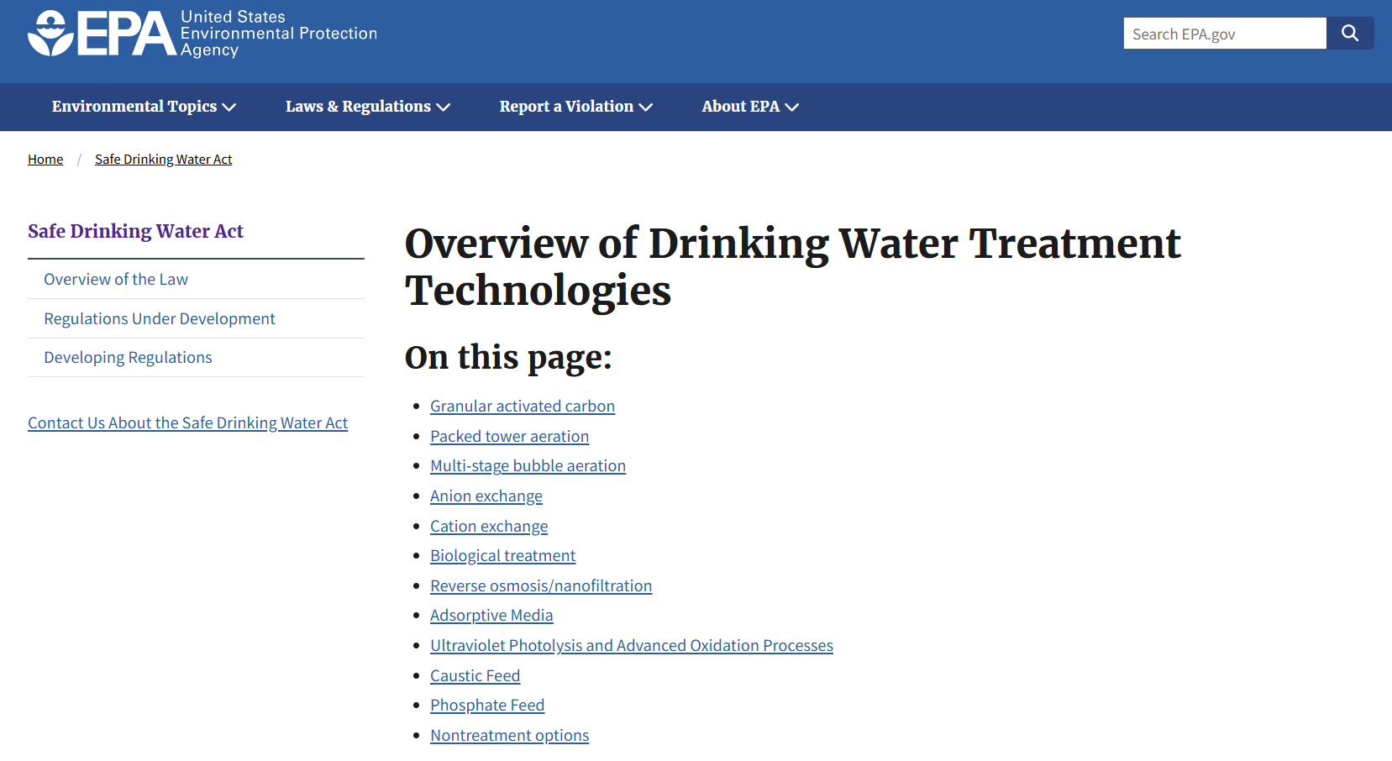
https://www.epa.gov/sdwa/overview-drinking-water-treatment-technologies

Slide 59
USEPA REGULATIONS PROJECT (ENV6666)
The goal of the project is for you to educate your classmates on the following aspects of your assigned contaminant:
What is the toxicity? (Review the toxicology data used in setting the MCL from the IRIS database)
What is the occurrence? Touch on two aspects of occurrence (remember, CWS only). Please analyze the data both by state occurrence and system size. Try to classify who is impacted by this contaminant.
Using the Six year review data---look at the distribution of concentrations for that contaminant. How does it break down? Are there systems that are more likely to have higher concentrations (system size? source water type? etc)
Using SDWIS Federal reports—review MCL violation data for that contaminant on a national basis. Are there geographical hotspots? Are there yearly trends? Hypothesis regarding trends?
What happens if a utility exceeds the regulatory threshold (MCL)?
Treatment---how can utilities effectively remove the contaminant.
Report: Two-page briefing memo per group, uploaded by one member to Canvas (due Dec 6th).
Presentation: Dec 3rd and 5th. Each person will present a 10 min presentation on your results. Highlight the why we should care and the results/discussion and conclusions. All members must participate in the presentation for a grade.

Slide 60
Other useful databases for data work!
General Flow for Data Processing: Methods to stitch multiple databases
USEPA Databases
US Census Bureau Databases
Processed Data
ECHO Facility Registry Service (FRS) Download
Contains linkages between program record:
PGM_SYS_ID, REGISTRY_ID, FIPS, ZIPCODE
Set PGM_SYS_ID to “SFDW” then REGISTRY_ID becomes PWSID and we can further match each unique PWSID and their ZIP_CODE to get FIPS_CODE. FIPS_CODE can be used to stitch data with other databases to get geographic info (lat/long) for spatial analysis, census/SVI analysis, environmental justice, and more.
Match by PWSID
Unregulated Contaminant Monitoring Rule (UCMR)
Monitor unregulated contaminants selected from contaminant candidate list (CCL). New list every 5 years.
Match by FIPS
Census, CDC/ATSDR Social Vulnerability Index (SVI), Environmental Justice Index (EJI)
Reports census data which includes demographics data, socioeconomic, SVI, EJI, and more…
Master Dataset
Ready for temporal and spatial analysis which can be analyzed using:
R software for statistical analysis.
GIS for geographic data analysis.
Safe Drinking Water Information System (SDWIS)
Reports violations, treatment, geographic area, water system info (size/source), water system facility info (seller/buyer), and more…
Six-Year Review (SYR)
Reports regulated contaminant concentrations and occurrences over time.
Think about how to handle censored and missing data, inadequate reporting practices; what variables to select, what aggregation methods (e.g. yearly, quarterly, monthly), what models to use (e.g. multilevel, correlation analysis, causal impact time series, probit/logit, etc.), note how many data gets dropped or excluded.

